Slide 1

FINDING HOSPITALS
By Unhandled Exceptions

Slide 2
`
NAME | EMPLOYEE ID
Choudhary Afzal Anwar | 890621
Zeeshan Mustafa | 890556
Aniruddha Manna | 889957
Jannela Jothish Chandr | 891069
Akash Mali | 890861
MEMBERS OF
UNHANDLED
EXCEPTIONS

Slide 3
05
02
01
08
04
03
CONTENTS
PROJECT STRUCTURING
Components used
JENKINS
Project Description
TEST CASE DESIGNING
07
Reporting
10
Selenium GRID
WORKFLOW
09
GITHUB
06
DATA driven framework

Slide 4
Project Description
1. Retrieving the hospital list after entering location as “Bangalore”, keyword as “hospital” and adding filters for “Open 24x7” & “Has Parking” facilities
2. Retrieving the Top Cities list after entering the Diagnostics webpage
Practo is an online health consultation website that provides online healthcare. We are taking and testing the following functionalities of the website
www.practo.com
3. Retrieving the alert message after entering invalid details in the Corporate Wellness webpage & scheduling a demo.

Slide 5
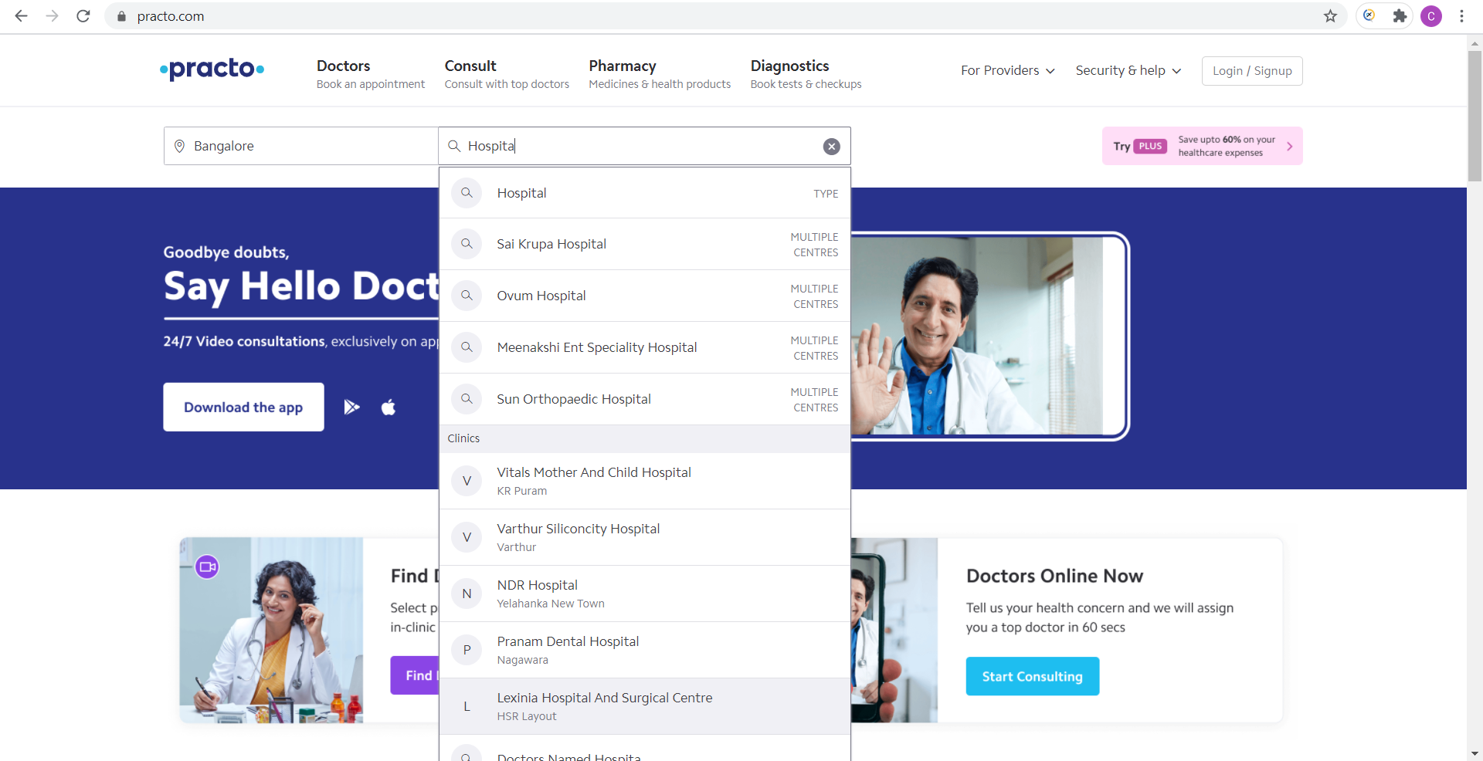
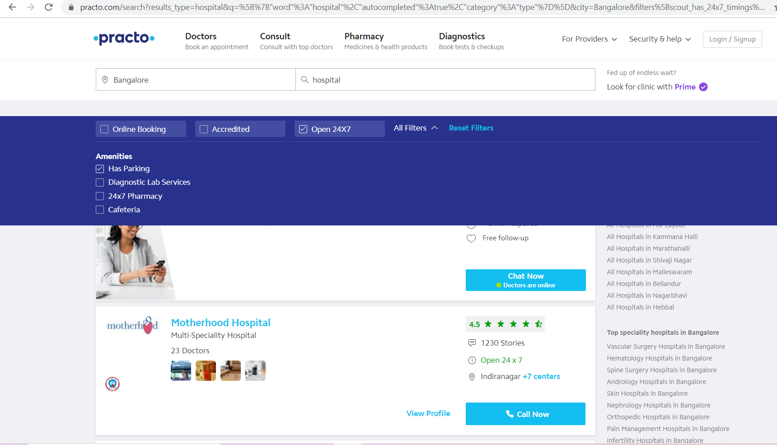
Screenshots OF The Website
LANDING PAGE
HOSPITAL LIST PAGE

Slide 6
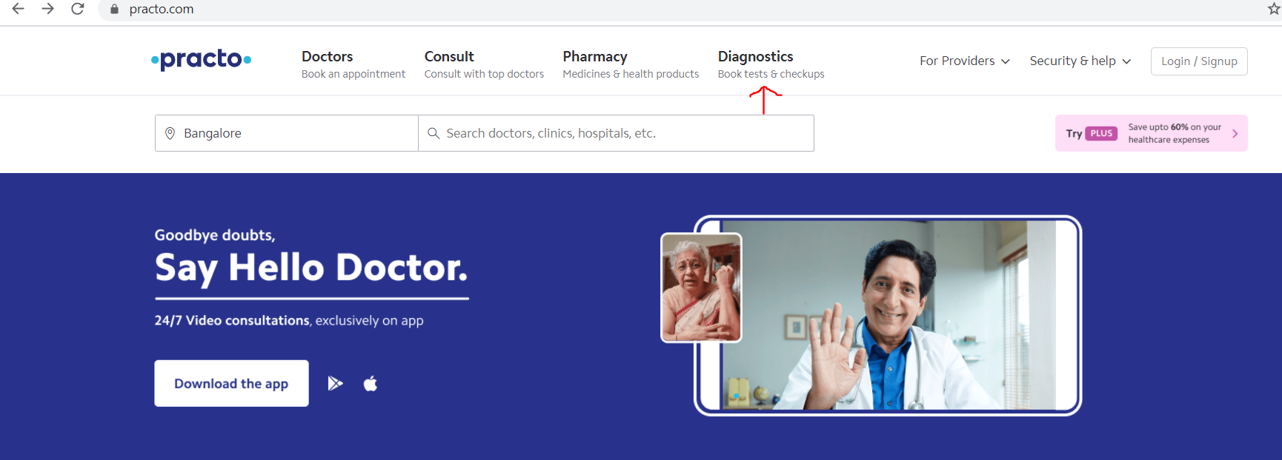
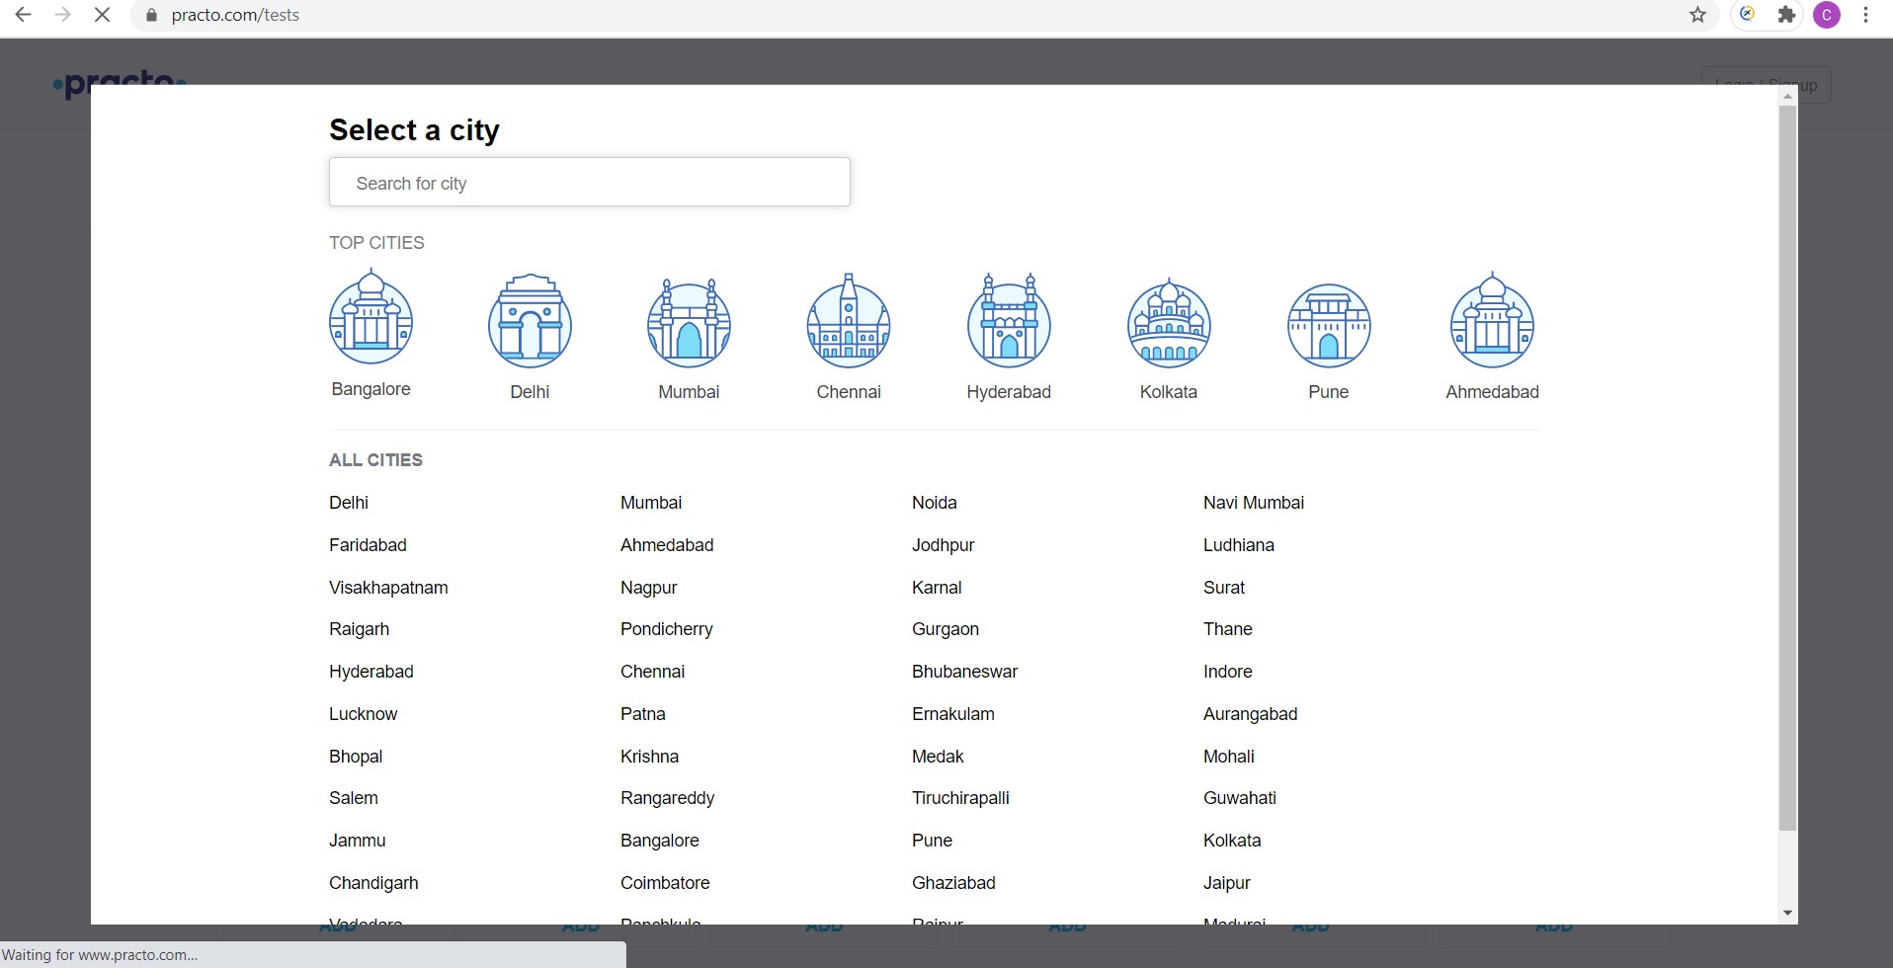
Screenshots OF The Website
LANDING PAGE
TOP CITIES PAGE

Slide 7
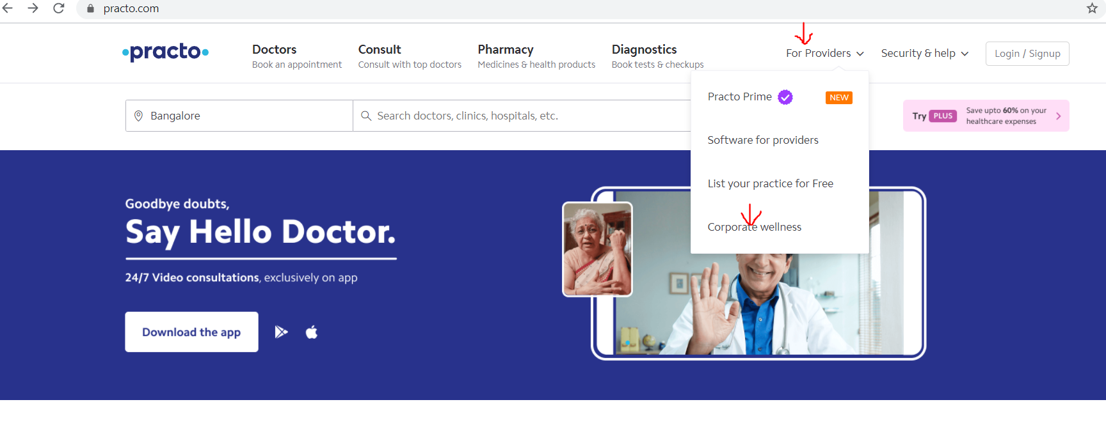

Screenshots OF The Website
LANDING PAGE
CORPORATE WELLNESS PAGE

Slide 8
Components used
Selenium
Java
Testng
pom
Jenkins
Portable framework for testing web applications
Java is a class-based, object-oriented programming language
Testing framework for the java programming language
Design pattern in Selenium that creates an object repository for storing all web elements
Jenkins is a free and open source automation server
Eclipse
Maven
Selenium Grid
GITHUB
Eclipse is an integrated development environment used in computer programming
Build automation tool used primarily for Java projects
Smart proxy server that makes it easy to run tests in parallel on multiple machines
Provider of Internet hosting for software development and version control using Git

Slide 9
WORKFLOW
08
GitHub
Using GitHub as a code repository for the ensuing project
07
Selenium Grid
06
Setting a server in selenium grid to run the tests parallelly
Jenkins
Creating a Jenkins server for continuous integration
05
Implementing Extent Reports
Using ExtentReports Library to increase the standard of the generated reports
04
Formulation of Test scripts
03
Project structuring
Writing the Code Using Java
Deciding the frameworks and models to be implemented in the project
02
01
Test case Designing
Requirement Analysis
It includes processes for the identifying test cases by enumerating steps of the defined test conditions
Requirements analysis focuses on the tasks that determine the needs or conditions to meet the new or altered product or project

Slide 10
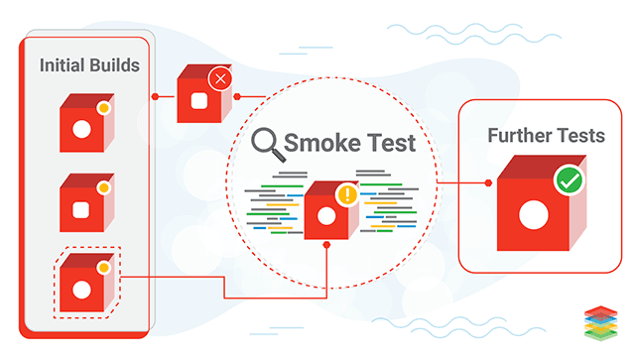
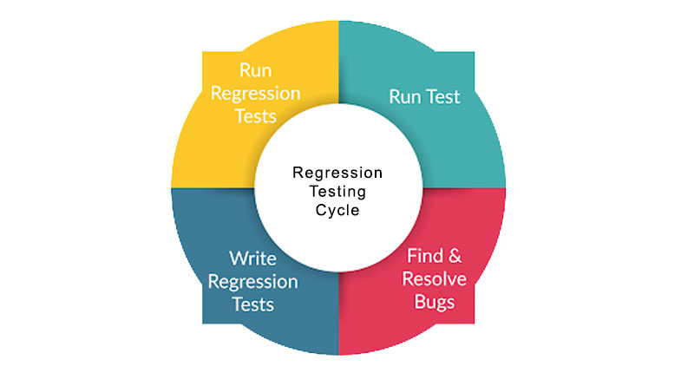
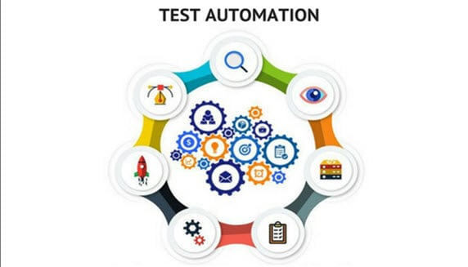
Test case designing
Smoke
Regression
Automation
Test cases that cover the most important functionality of a component or system
Smoke testing is also done by testers before accepting a build for further testing
Regression testing is re-running functional and non-functional tests to ensure that previously developed and tested software still performs after a change
Set of functional test cases validating the requirements of the application

Slide 11
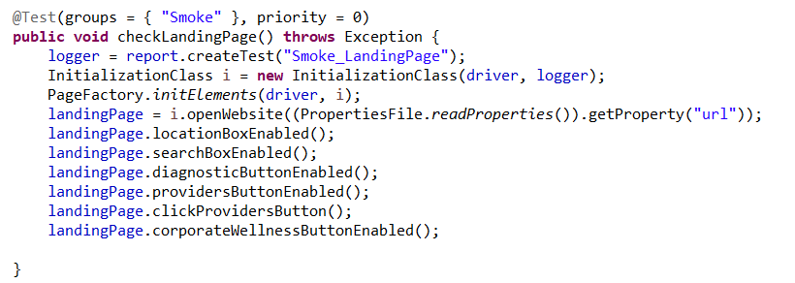
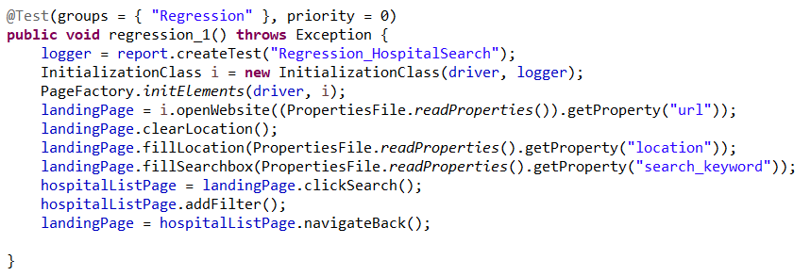
Screenshots of Test Case Designs
SMOKE
REGRESSION

Slide 12
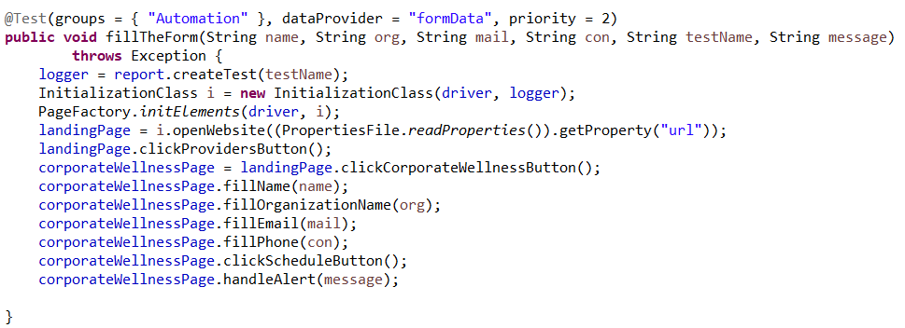
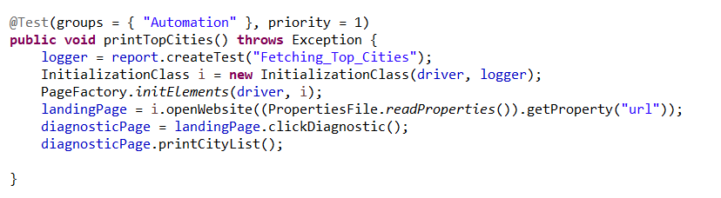
Screenshots of Test Case Designs
AUTOMATION

Slide 13
Project Structuring
MAVEN
Java
SELENIUM
Used this build automation tool to resolve dependency related issues while running the project in different environments
Used this High Level Language for creating the project
Used this automation framework for automating our test scripts using different browsers
TESTNG
POM
Used this framework for controlling the flow of the tests and validating them
Used this framework for creating the object repository and reducing code duplication and improving test maintainence

Slide 14
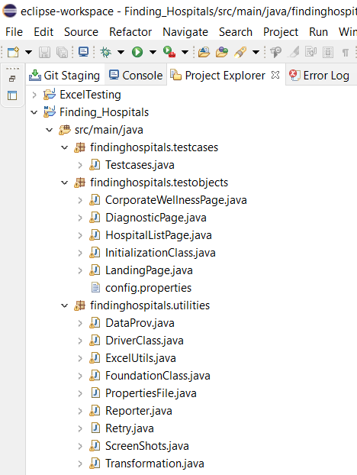
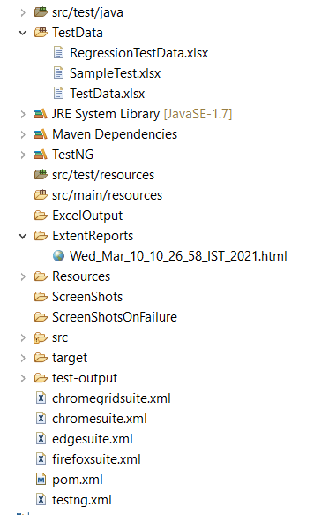
Screenshots of Project structure
PROJECT STRUCTURE BASED ON PAGE OBJECT MODEL

Slide 15
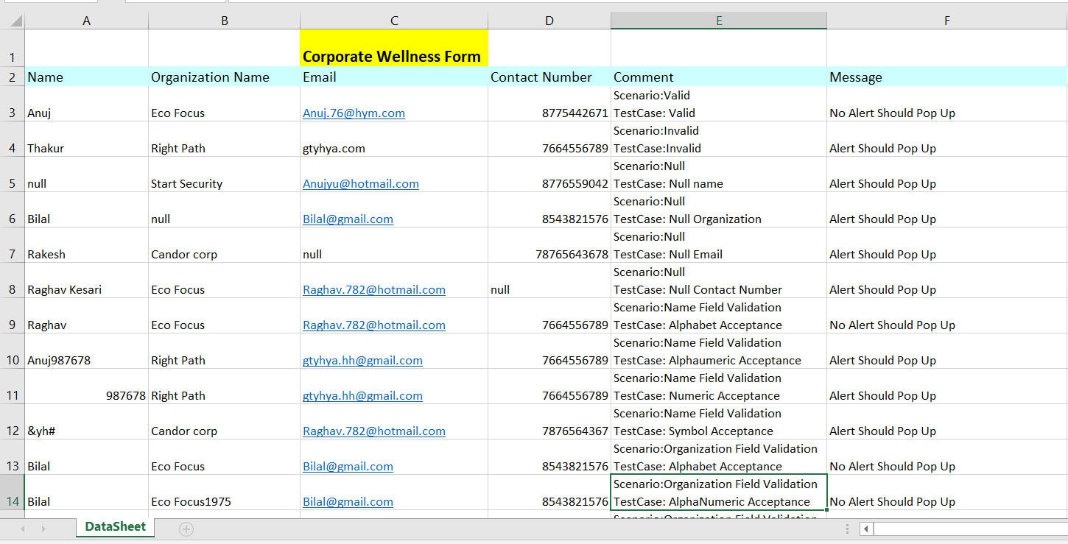
Data Driven framework
EXCEL SHEET FOR PROVIDING DATA TO THE TEST CASES

Slide 16
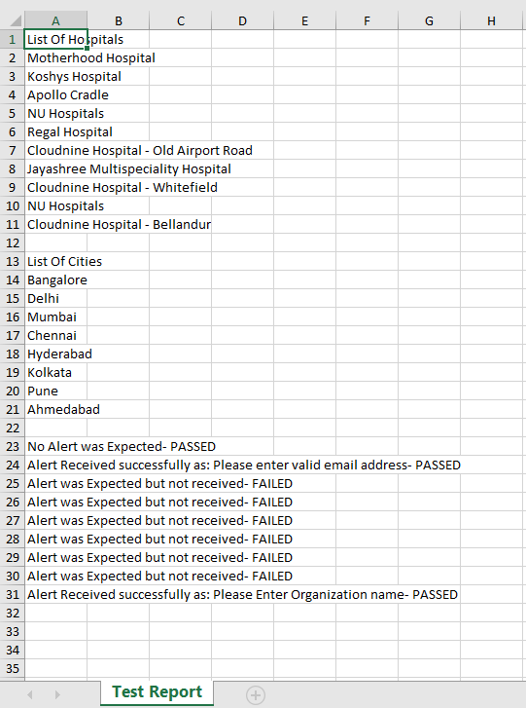
Excel Output
Printing the output in the Excel

Slide 17
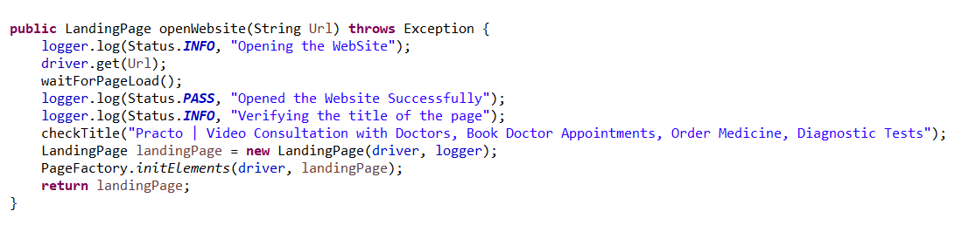
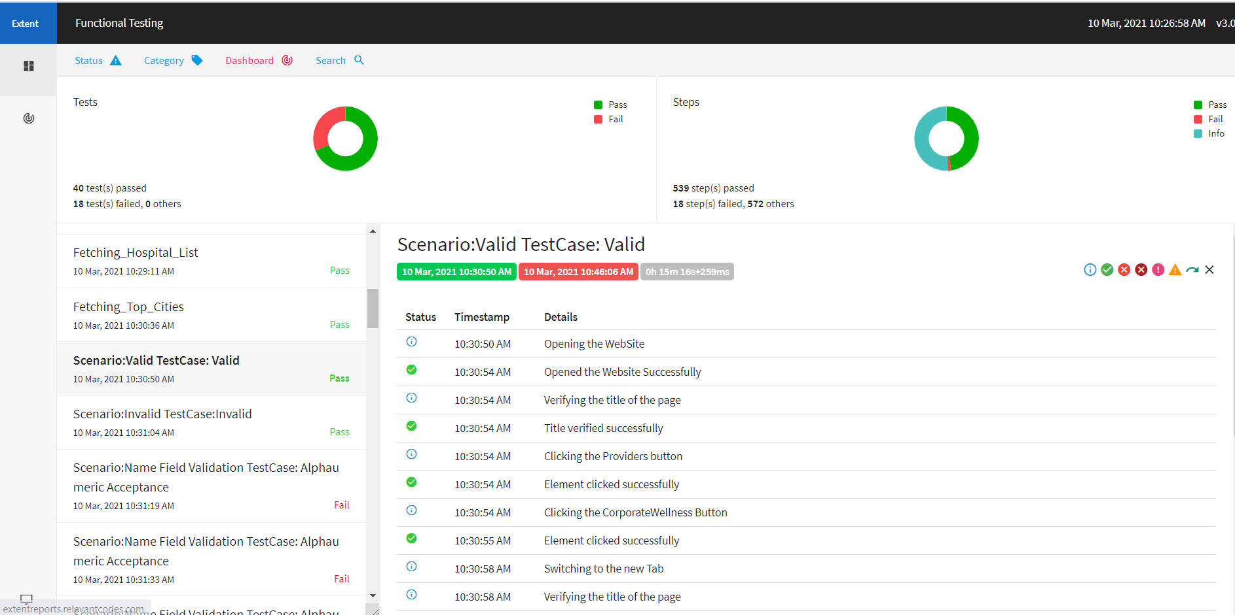
REPORTING
Logging status into the report
Screenshot of the Final Report

Slide 18
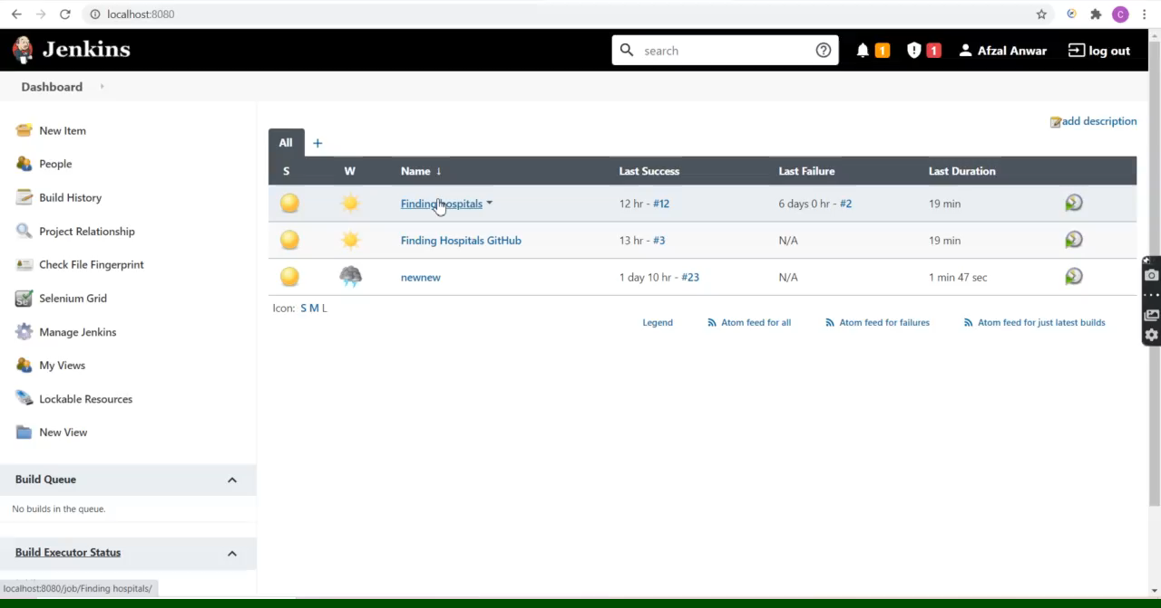
JENKINS
Building our Project in the Jenkins Server

Slide 19
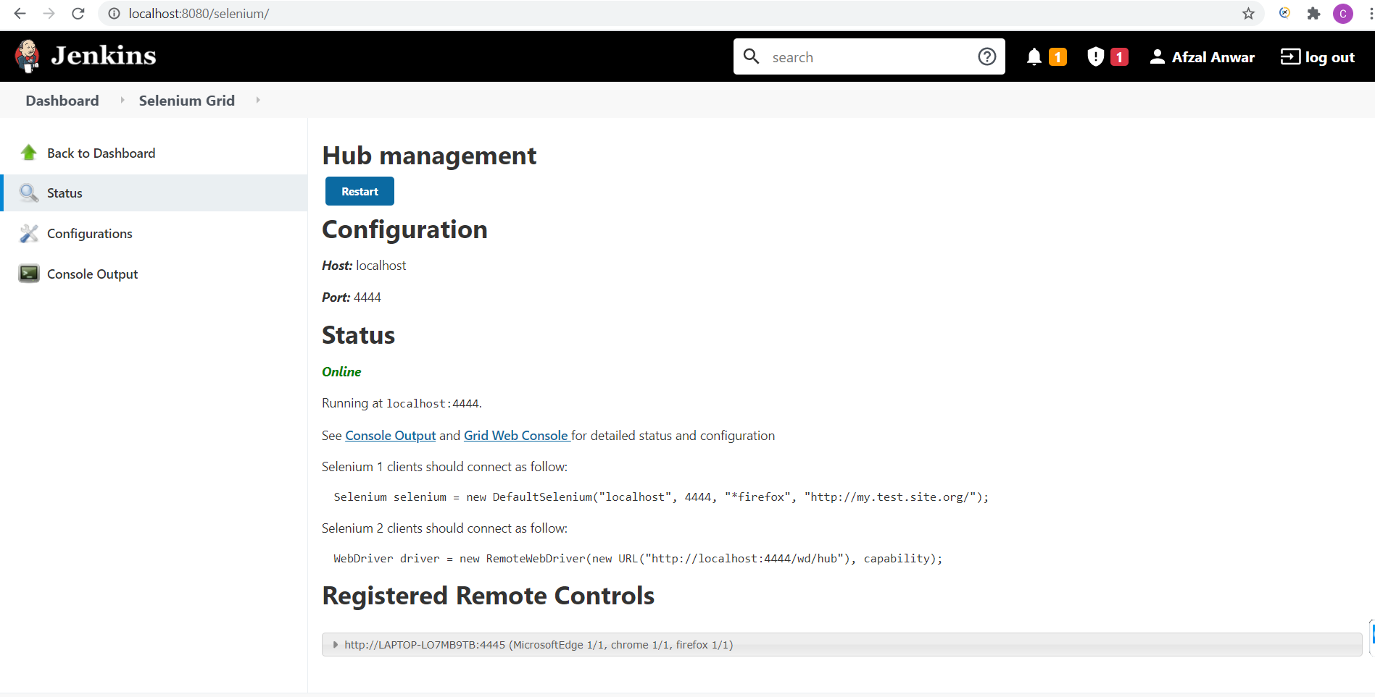
SELENIUM GRID
Registered RC’s

Slide 20
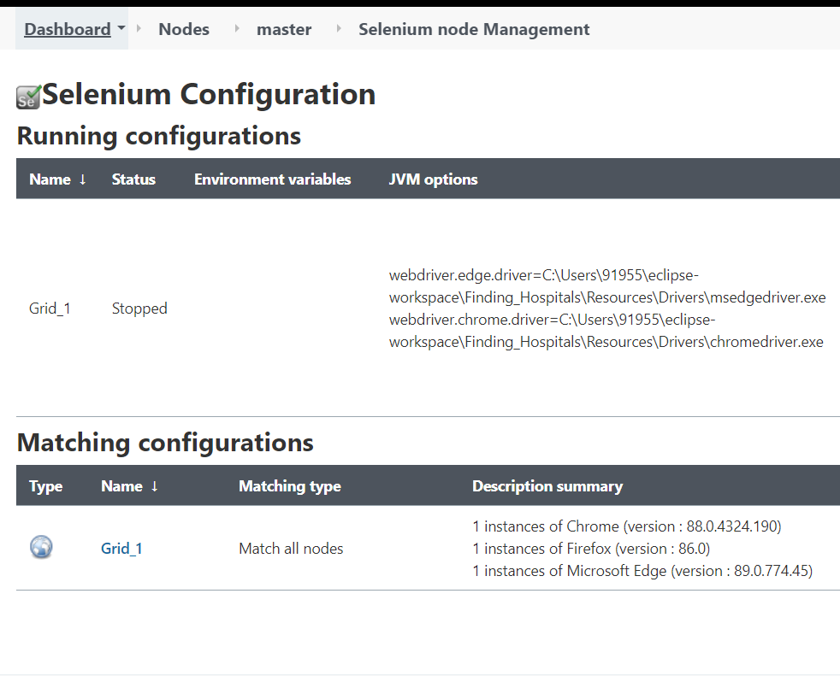
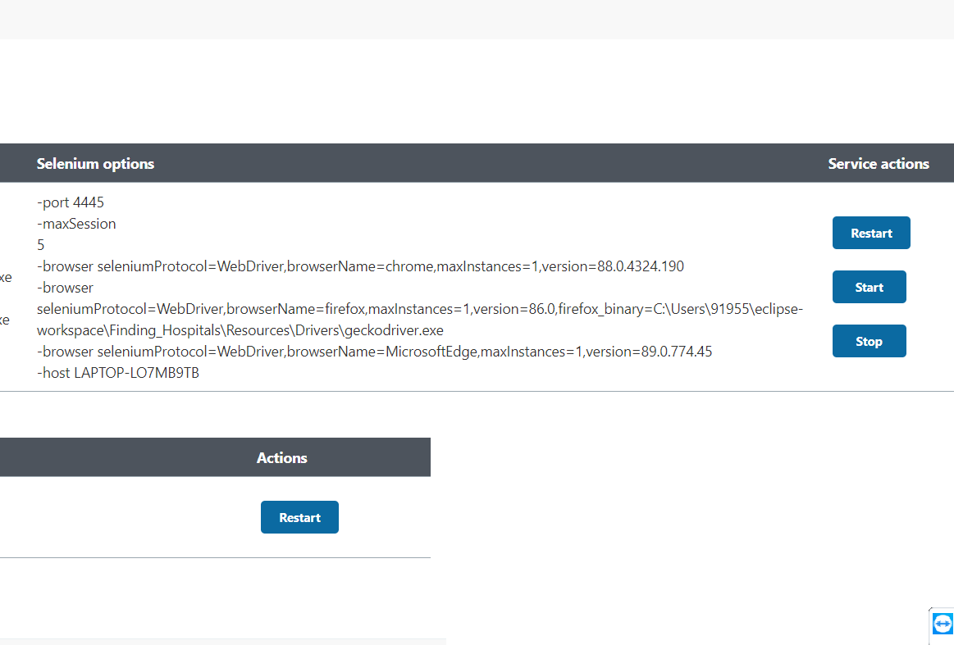
SELENIUm GRID
Selenium Grid Configuration in the Jenkins Server

Slide 21
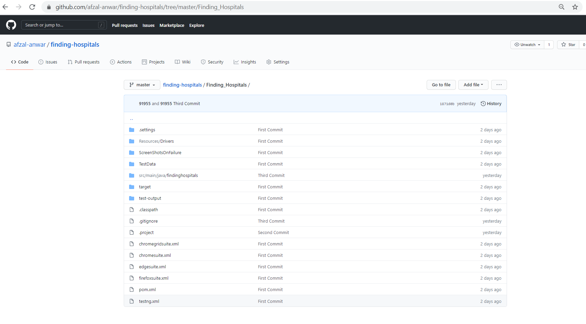
GITHUB
Final Committed Code in the GitHub Repository

Slide 22


